Slide 1
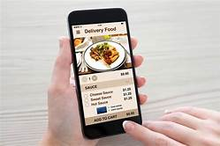
SE COURSE BASED PROJECT ON- ONLINE FOOD DELIVERY SYSTEM
TEAM MEMBERS:
S SAI SAMANVITHA-20071A05A9
A DAVID-21075A0507
CH POOJITHA-21075A0508
G KAVITHA-21075A0509
P HARIPRIYA-21075A0510
PROJECT GUIDE-
RAMA KRISHNA SIR

Slide 2
AGENDA
INTRODUCTION
ABSTRACT
SOFTWARE REQUIREMENTSPECIFICATION
USE CASE DIAGRAMS
PROBLEM STATEMENT

Slide 3
INTRODUCTION
The "Online Food Ordering System" has been developed to override the problems prevailing in the practicing manual system.
This software is supported to eliminate and, in some cases, reduce the hardships faced by this existing system.
The application is reduced as much as possible to avoid errors while entering the data.
It also provides error message while entering invalid data.
It can assist the user to concentrate on their other activities rather to concentrate on the record keeping.
Online Food Ordering System, as described above, can lead to error free, secure, reliable and fast management system.
Thus, it will help organization in better utilization of resources.

Slide 4
ABSTRACT:
The purpose of Online Food Ordering System is to automate the existing manual system by the help of computerized equipment’s and full-fledged computer software.
By Fulfilling their requirements, their valuable data/information can be stored for a longer period with easy accessing and manipulation of the same.
Online Food Ordering System, as described above, can lead to error free, secure, reliable and fast management system.
The organization can maintain computerized records without redundant entries.
Basically the project describes how to manage for good performance and better services for the clients.

Slide 5
PROBLEM STATEMENT:
In the present scenario, people have to physically visit the hotels or restaurants for eating food and have to make payments through cash mode most of the time due to unawareness of advanced technologies at certain places.
In this method time as well as physical work is required, among which time is something that no one has in ample amount.
The traditional food ordering procedure is not efficient enough for hotels and restaurants, as they have to deal with the crowd, in their restaurant.
The old methods can be classified into categories which are paper grounded and verbal grounded. For paper-based work, the waiter comes and pens down foods that customers order and pass the food list containing paper to the chefs or cooks in the kitchen for further process.
Also, from the owner’s point of view maintaining data records and the accounts in the physical file are cumbersome and tedious work to do. And also, it is full of risk as anyone can access it and modify the data.

Slide 6
SOFTWARE REQUIREMENTS SPECIFICATION:
The Software Requirements Specification is produced at the culmination of the analysis task.
The function and performance allocated to software as part of system engineering are refined by establishing a complete information description, a detailed functional and behavioral description, an indication of performance requirements and design constraints, appropriate validation criteria, and other data pertinent to requirements.
The proposed system has the following requirements:
System needs store information about new entry of Food Item.
System needs to help the internal staff to keep information of Category and find
them as per various queries.
System need to maintain quantity record.
System need to keep the record of Customer.
System need to update and delete the record.
System also needs a search area.
It also needs a security system .

Slide 7
1.1 OBJECTIVES:
The main objective of the Project on Online Food Ordering System is to manage the details of Food Item, Category, Customer, Order, Confirm Order.
It manages all the information about Food Item, Payment, Confirm Order, Food Item.
The project is totally built at administrative end and thus only the administrator is guaranteed the access.
The purpose of the project is to build an application program to reduce the manual work for managing the Food Item, Category, Payment, Customer.
It tracks all the details about the Customer, Order, Confirm Order.

Slide 8
1.2 FUNCTIONALITIES:
Provides the searching facilities based on various factors. Such as Food Item, Customer, Order, Confirm Order
Online Food Ordering System also manage the Payment details online for Order details, Confirm Order details, Food Item.
It tracks all the information of Category, Payment, Order etc
Manage the information of Category
Shows the information and description of the Food Item, Customer
To increase efficiency of managing the Food Item, Category
It deals with monitoring the information and transactions of Order.
Manage the information of Food Item
Editing, adding and updating of Records is improved which results in proper resource management of Food Item data.
Manage the information of Order
Integration of all records of Confirm Order.

Slide 9
1.3 SCOPE:
It may help collecting perfect management in detail. In a very short time, the collection will be obvious, simple and sensible.
It will help a person to know the management of passed year perfectly and vividly.
It also helps in current all works relative to Online Food Ordering System.
It will be also reduced the cost of collecting the management & collection procedure will go on smoothly.
It satisfy the user requirement
Be easy to understand by the user and operator
Be easy to operate
Have a good user interface
Be expandable
Delivered on schedule within the budget.

Slide 10
1.4 MODULES:
Food Item Management Module: Used for managing the Food Item details.
Confirm Order Module : Used for managing the details of Confirm Order
Payment Module : Used for managing the details of Payment Category Management Module: Used for managing the information and details of the Category.
Customer Module : Used for managing the Customer details
Order Module : Used for managing the Order information’s
Login Module: Used for managing the login details
Users Module : Used for managing the users of the system

Slide 11
VALIDATIONS:
All the fields such as Food Item, Customer, Confirm Order are validated and does not take invalid values
Each form for Food Item, Category, Payment can not accept blank value fields
Avoiding errors in data
Controlling amount of input
Integration of all the modules/forms in the system.
Preparation of the test cases.
Preparation of the possible test data with all the validation checks.
Actual testing done manually.
Recording of all the reproduced errors.
Modifications done for the errors found during testing.
Prepared the test result scripts after rectification of the errors.
Functionality of the entire module/forms.
Validations for user input.
Checking of the Coding standards to be maintained during coding.
Testing the module with all the possible test data.

Slide 12
FEATURES:
It contains better storage capacity.
Accuracy in work.
Easy & fast retrieval of information.
Well-designed reports.
Decrease the load of the person involve in existing manual system.
Access of any information individually.
Work becomes very speedy.
Easy to update information

Slide 13
UML DIAGRAMS:
UML diagram is a diagram based on the UML (Unified Modeling Language) that is used to visually describe a system, including its major actors, roles, actions, artifacts, or classes, in order to better understand, edit, maintain, or document system information.
Software engineers use the UML modeling language to create diagrams and provide ready-to-use, expressive modeling examples to users (programmers).
UML diagrams are the visual designs or the blueprint of the system structure and behavior. Structural diagrams helps in building the structure of Online Food Ordering System while the behavioral diagrams in UML helps in determining its behavior towards the user, data inputs and producing an output. All of the UML diagrams works in sync and relatively to achieve a well-engineered project.

Slide 14
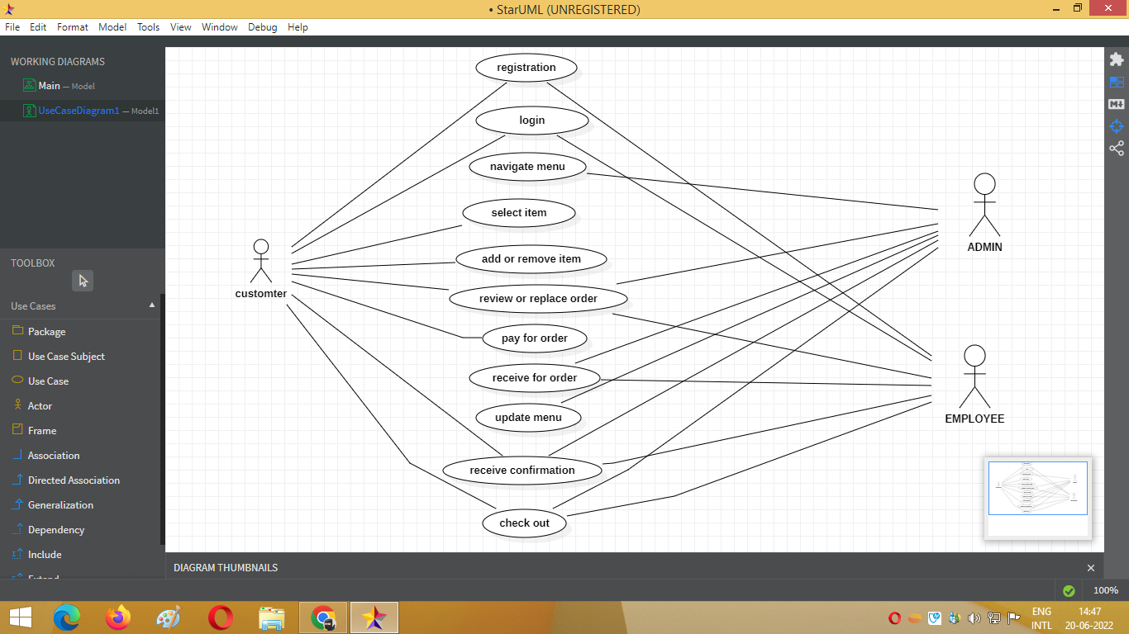
1. USE CASE DIAGRAM:

Slide 15
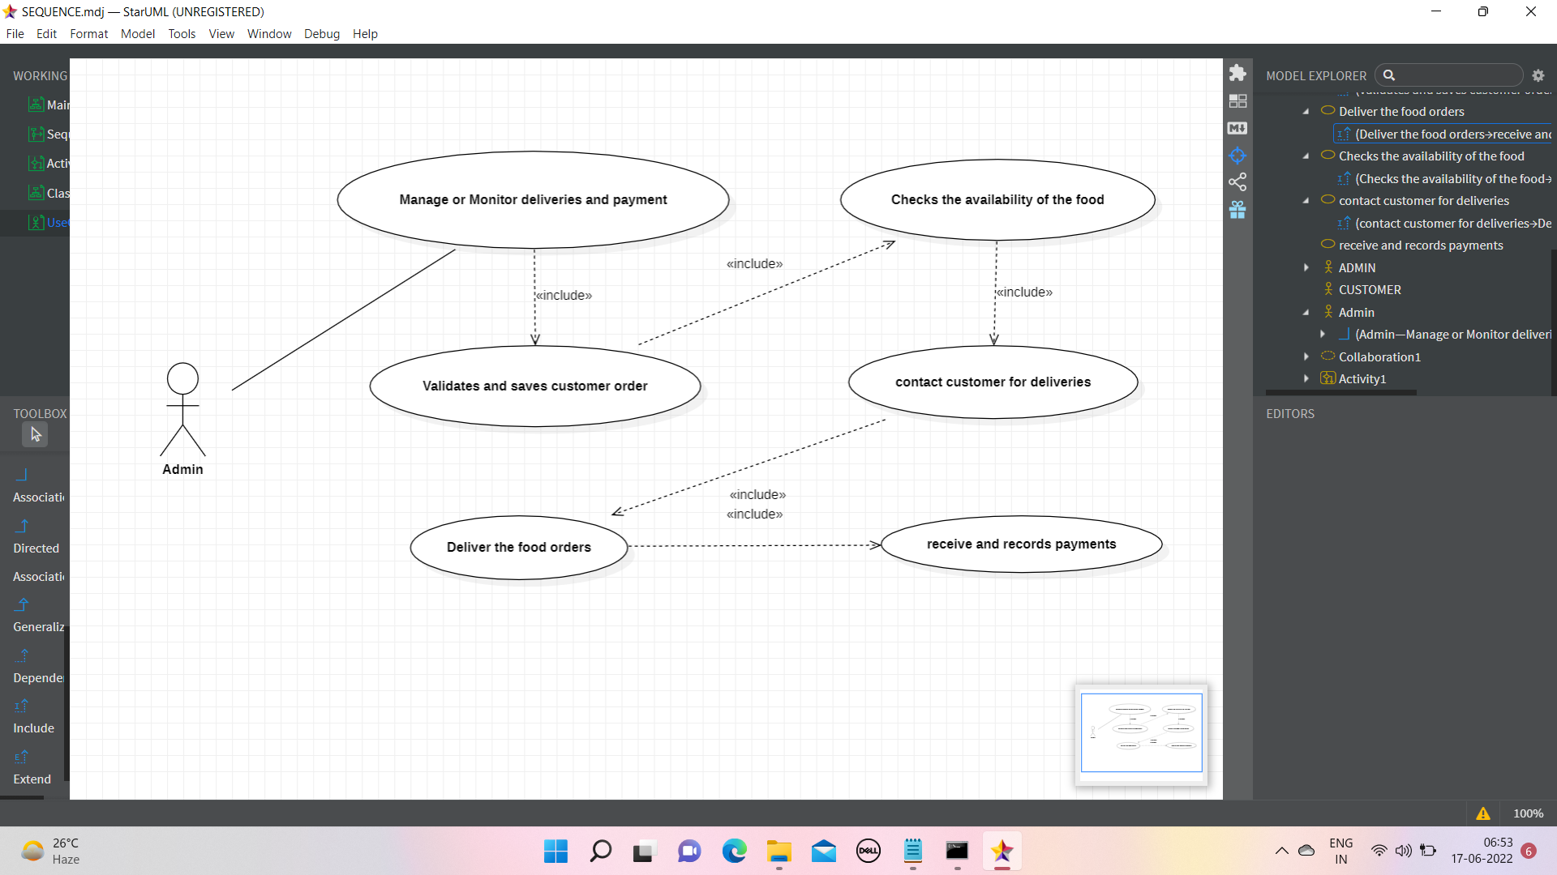
USE CASE DIAGRAM FOR MANAGING DELIVERIES AND PAYMENT:

Slide 16
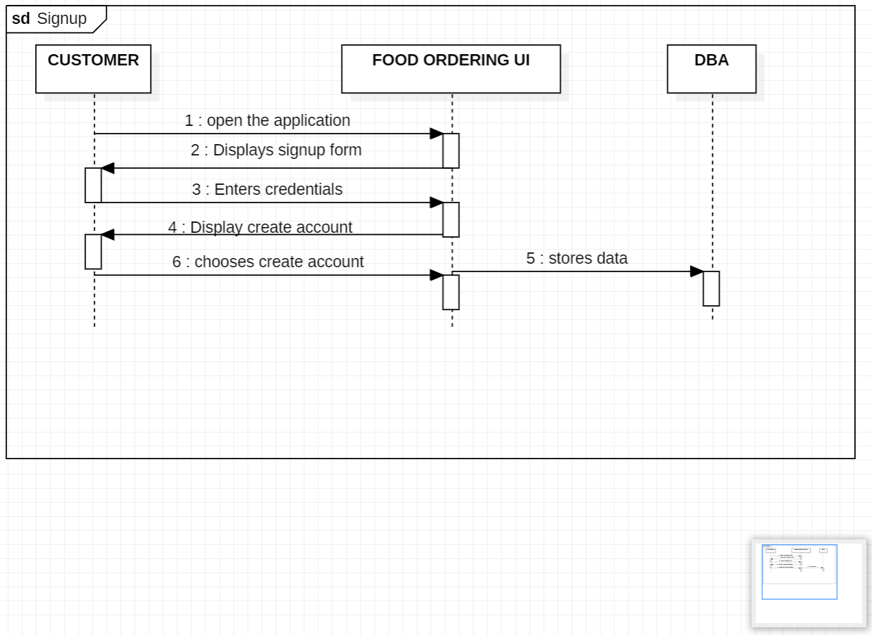
2.SEQUENCE DIAGRAM FOR SIGNUP:

Slide 17
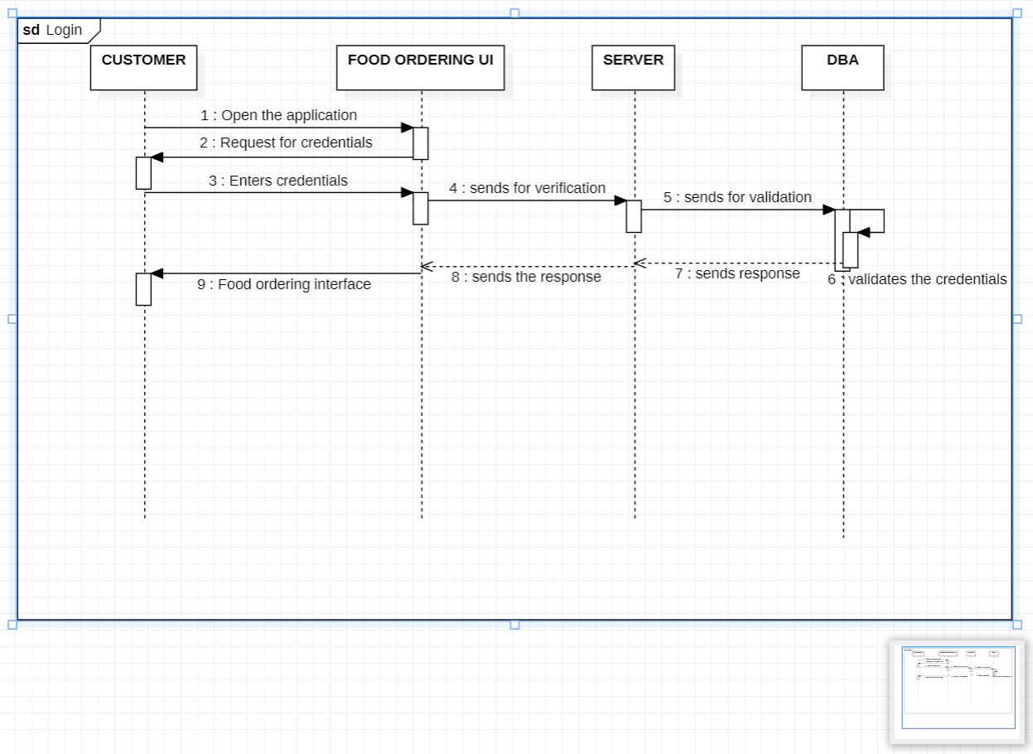
SEQUENCE DIAGRAM FOR LOGIN:

Slide 18
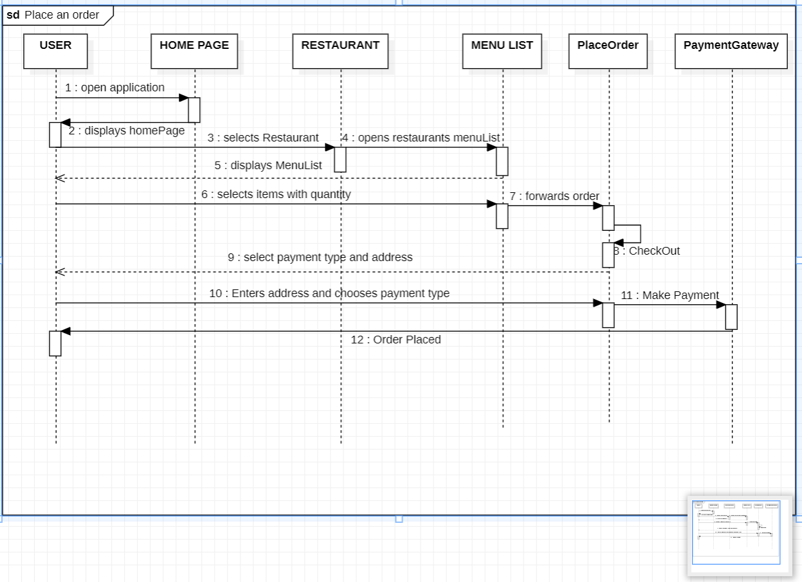
SEQUENCE DIAGRAM FOR PLACEING AN ORDER:

Slide 19
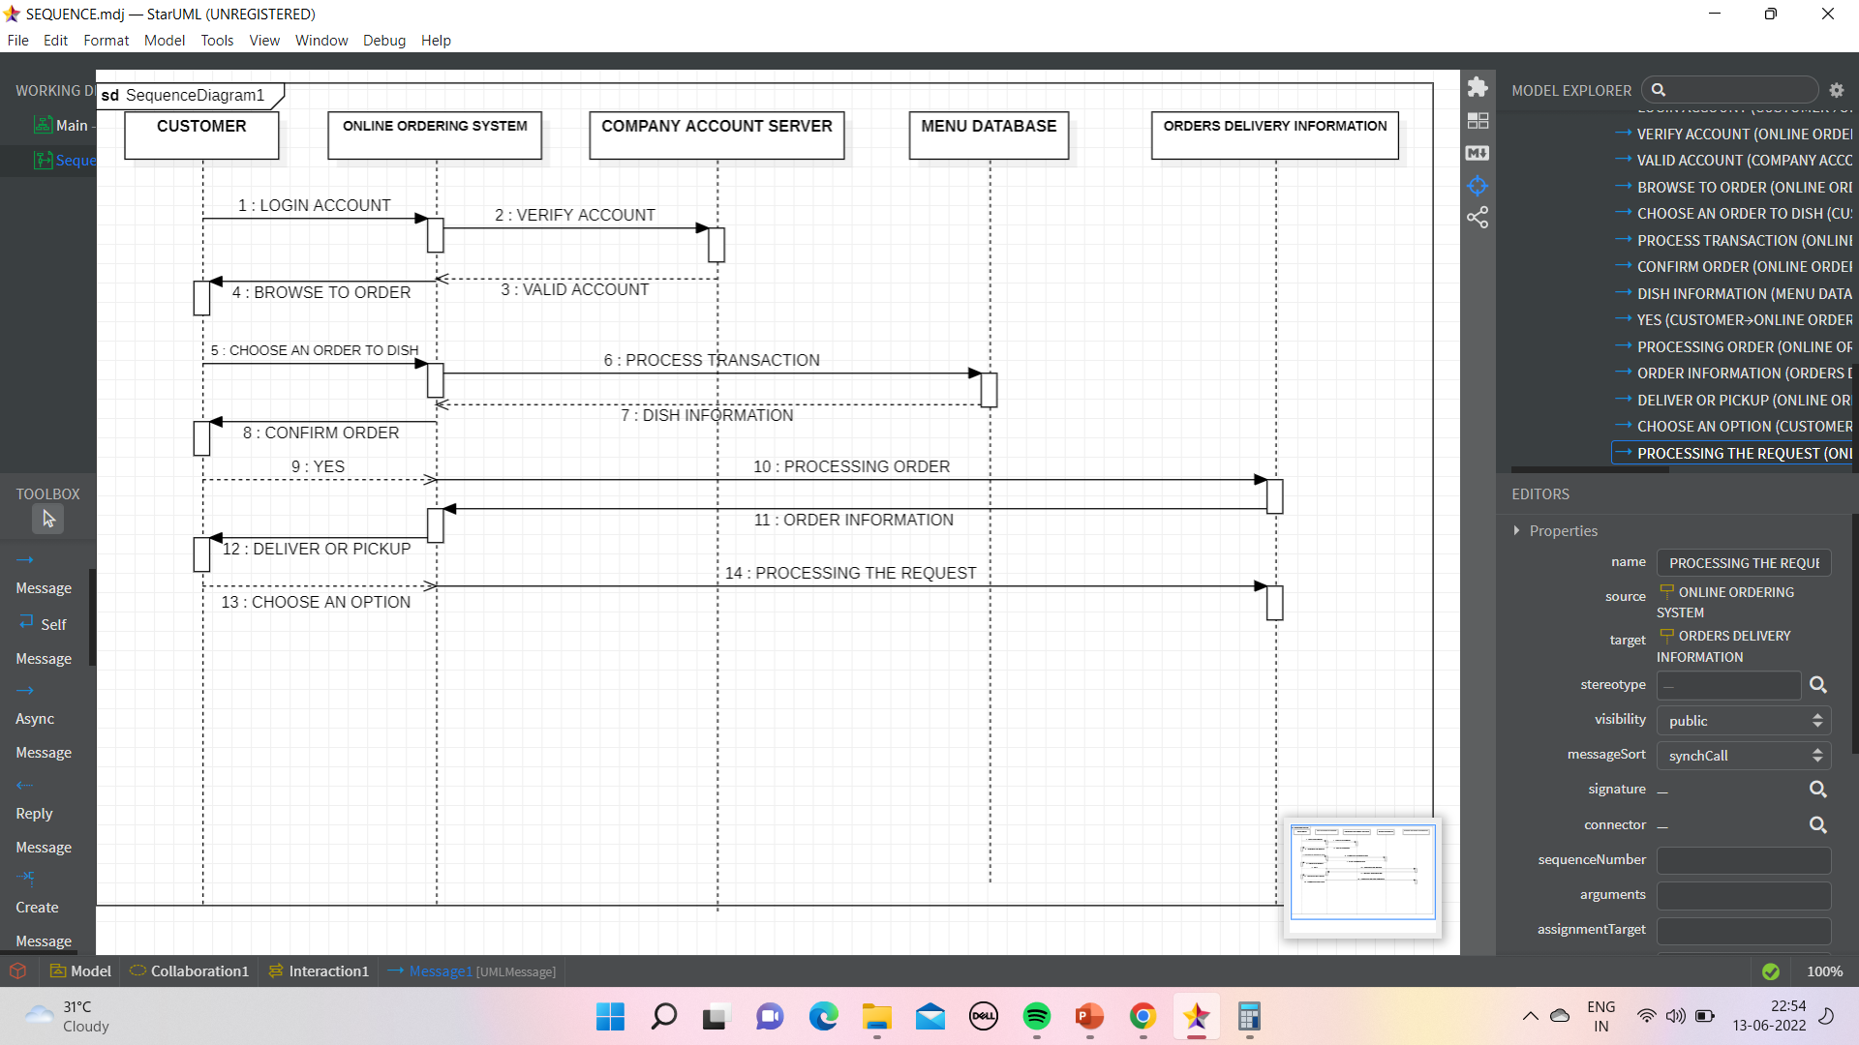
SEQUENCE DIAGRAM OF APPLICATION:

Slide 20
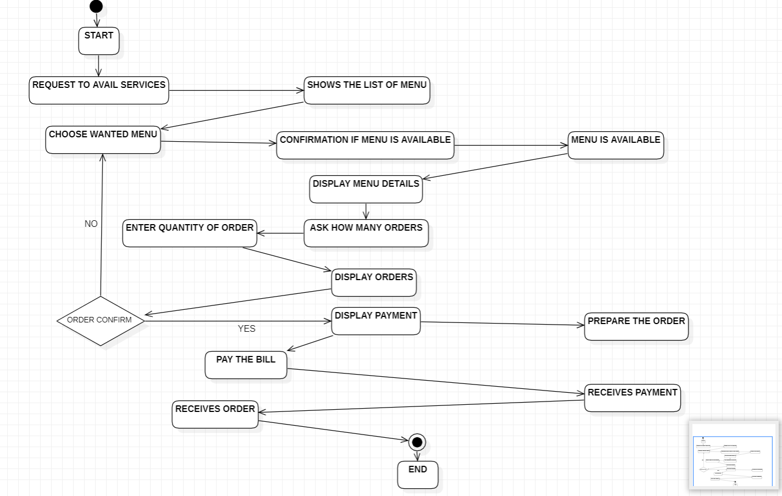
3.ACTIVITY DIAGRAM:

Slide 21
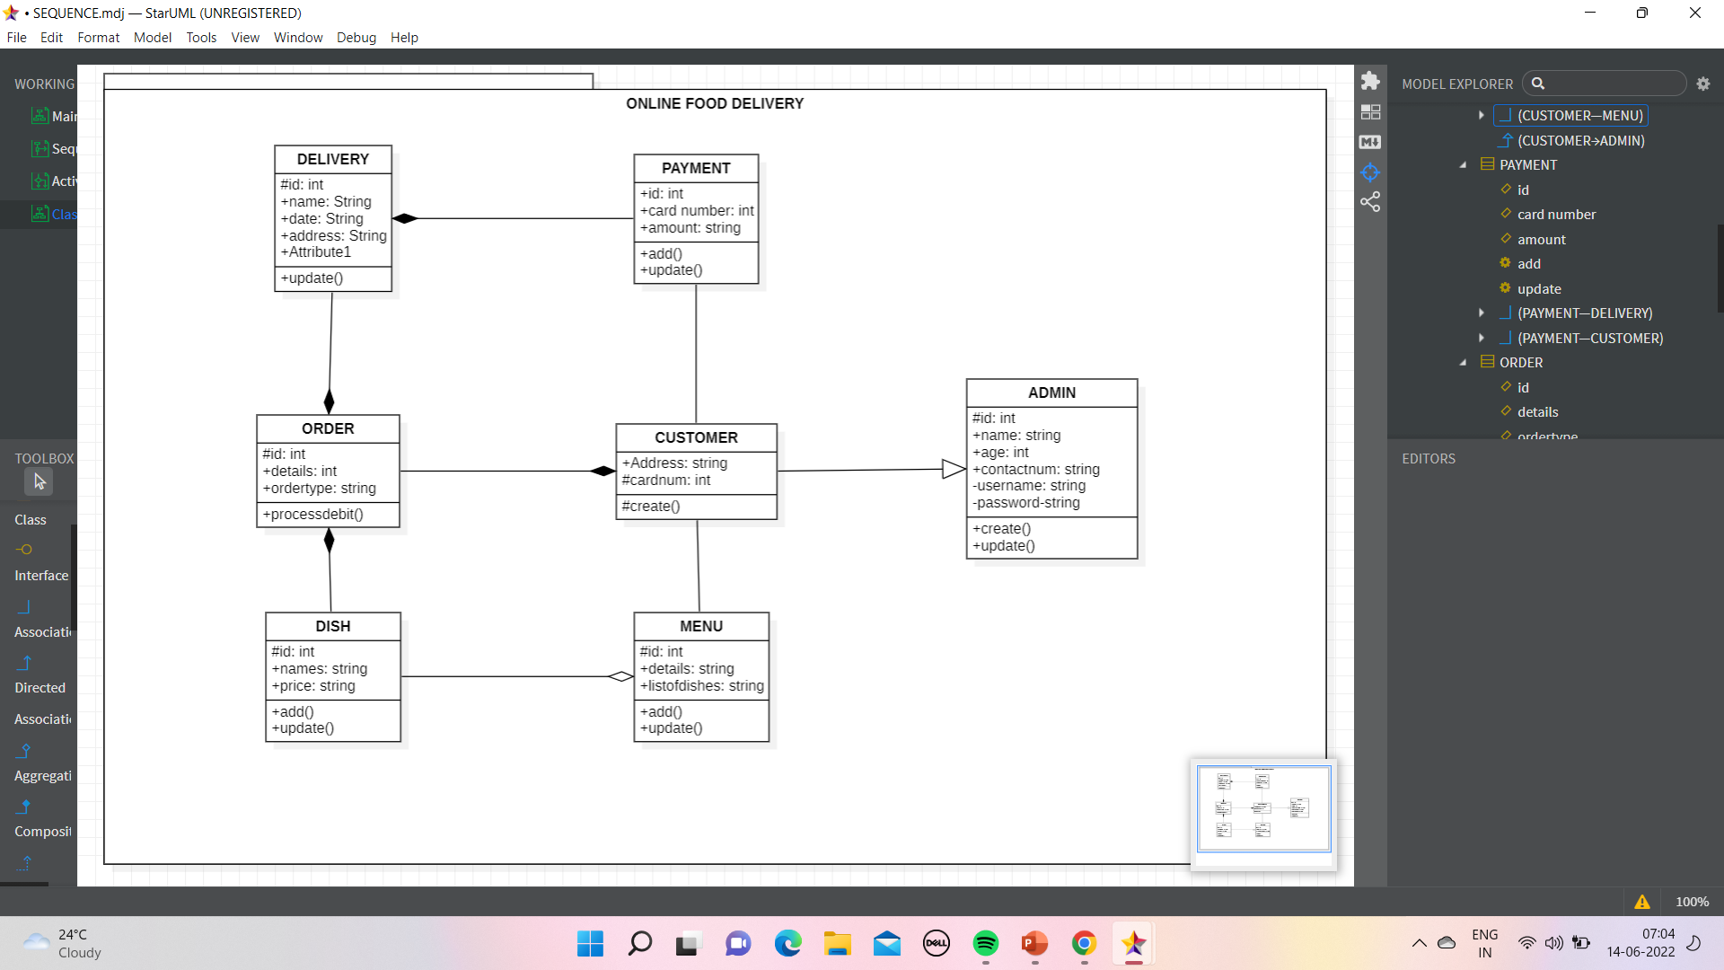
4.CLASS DIAGRAM:

Slide 22
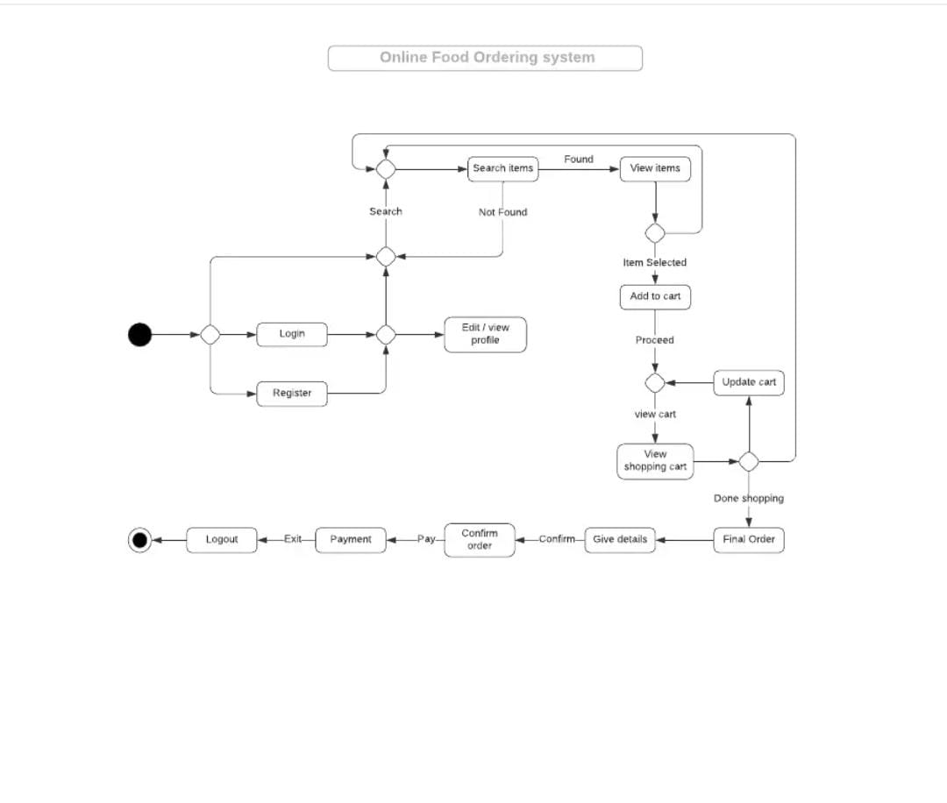
5.STATE CHART DIAGRAM:

Slide 23
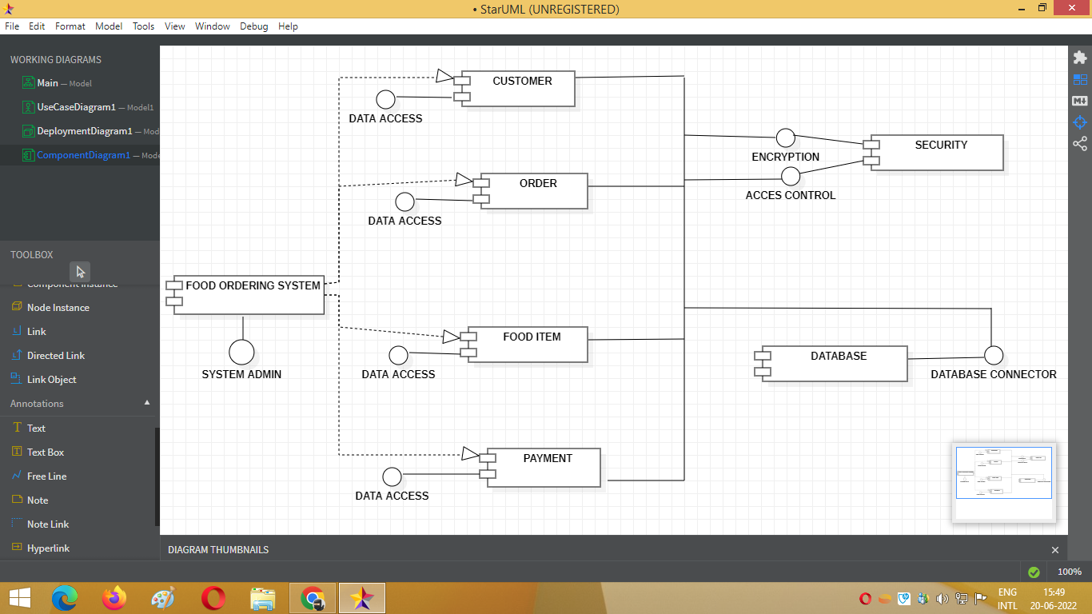
6.COMPONENT DIAGRAM:

Slide 24
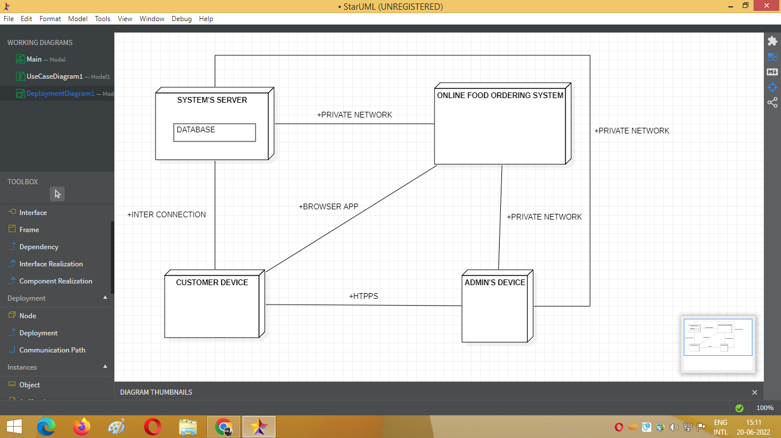
7.DEPLOYMENT DIAGRAM:

Slide 25

THANK YOU!!!

